Slide 1

CybShield
By the team THeCreative
Pawan Sunar
Misha Tamang
Krishna Sah
Yosheph Tamang
Priksha Rawat

Slide 2
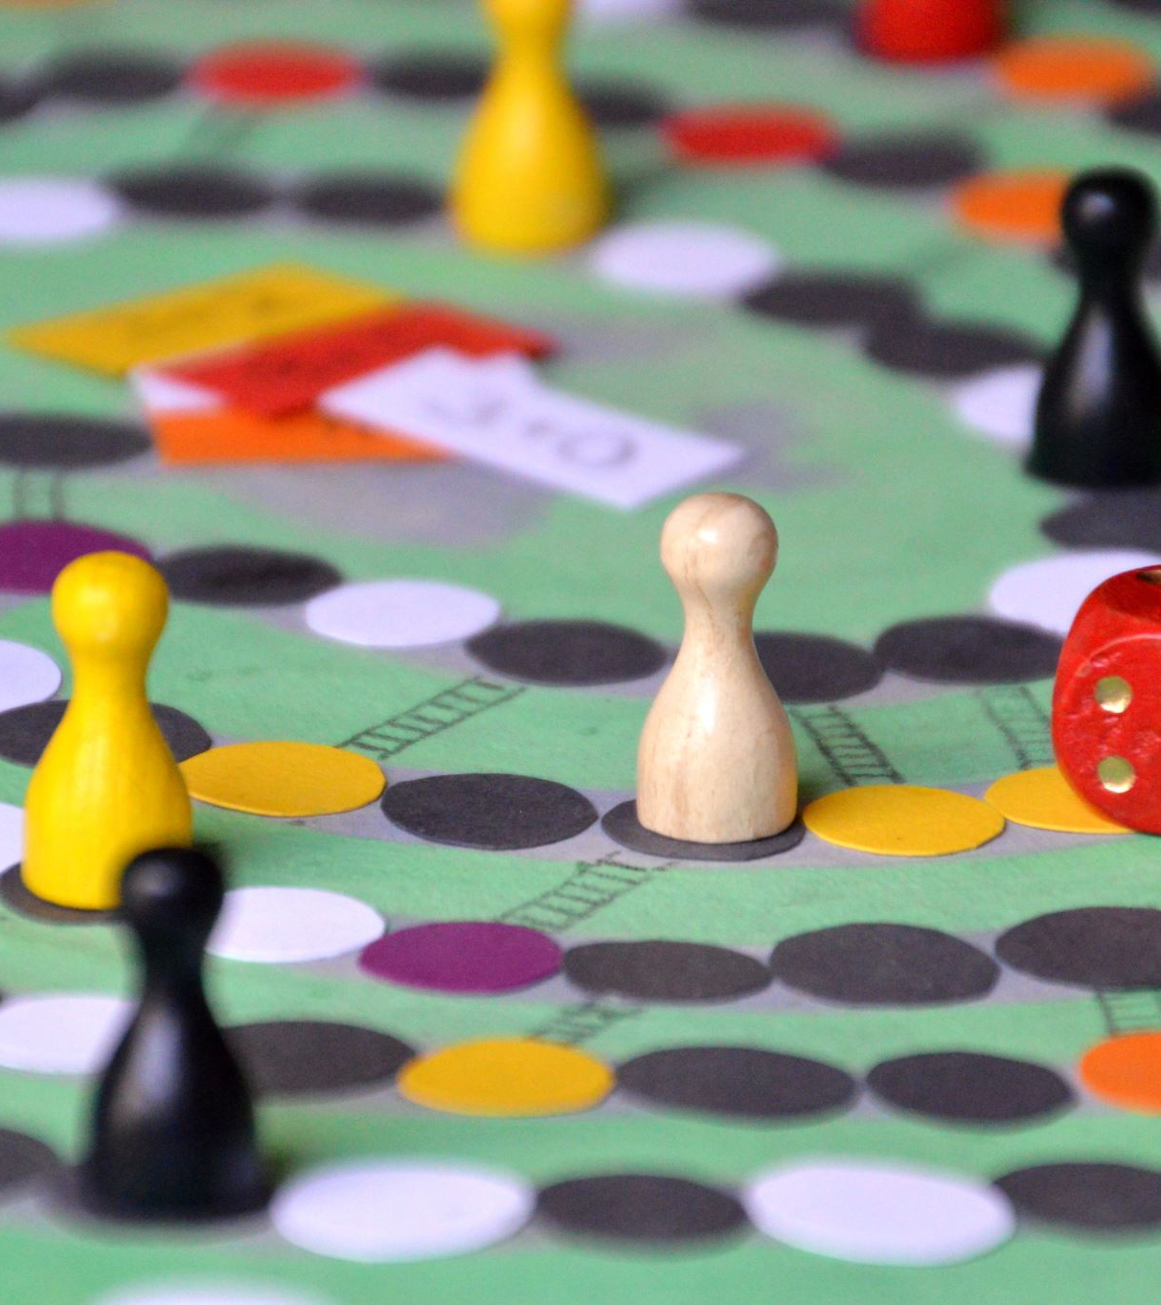
Game Concept
CybShield is a fun and interactive web-based quiz game.
The purpose of the game is to teach children about cyber safety using simple challenges and quiz questions.
Players will answer questions, receive feedback, earn rewards, and learn how to stay safe online.

Slide 3
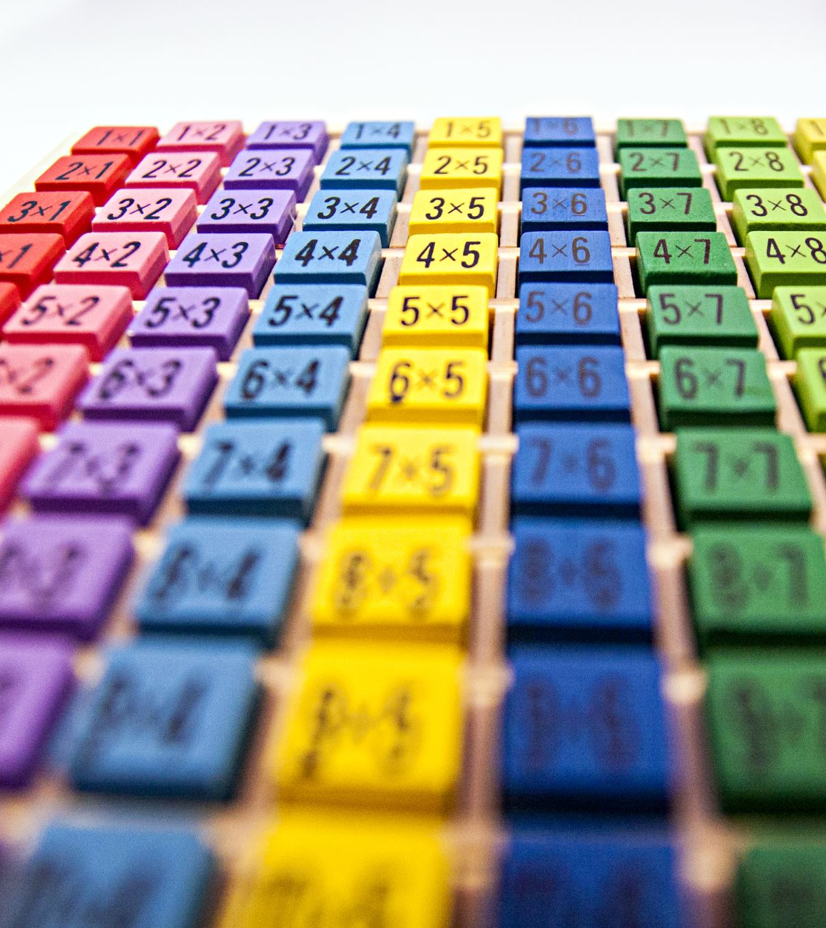
Target Audience
Our target audience is children aged 10 to 15 years old.
We selected this age group because many children use mobile phones, games, and social media but may not fully understand online dangers.
To make the game suitable for them, we used:
Bright colours
Simple instructions
Large buttons
Easy navigation
Reward systems
The game is designed to be fun, educational, and easy to understand.”

Slide 4

Cyber-Safety Topic
Our cyber-safety topic is Two-Factor Authentication, also known as 2FA.
2FA helps protect accounts by adding an extra security step during login.
In our game, players learn:
Why 2FA is important
How hackers steal passwords
How to stay safe online
How to identify fake login attempts and phishing scams”

Slide 5
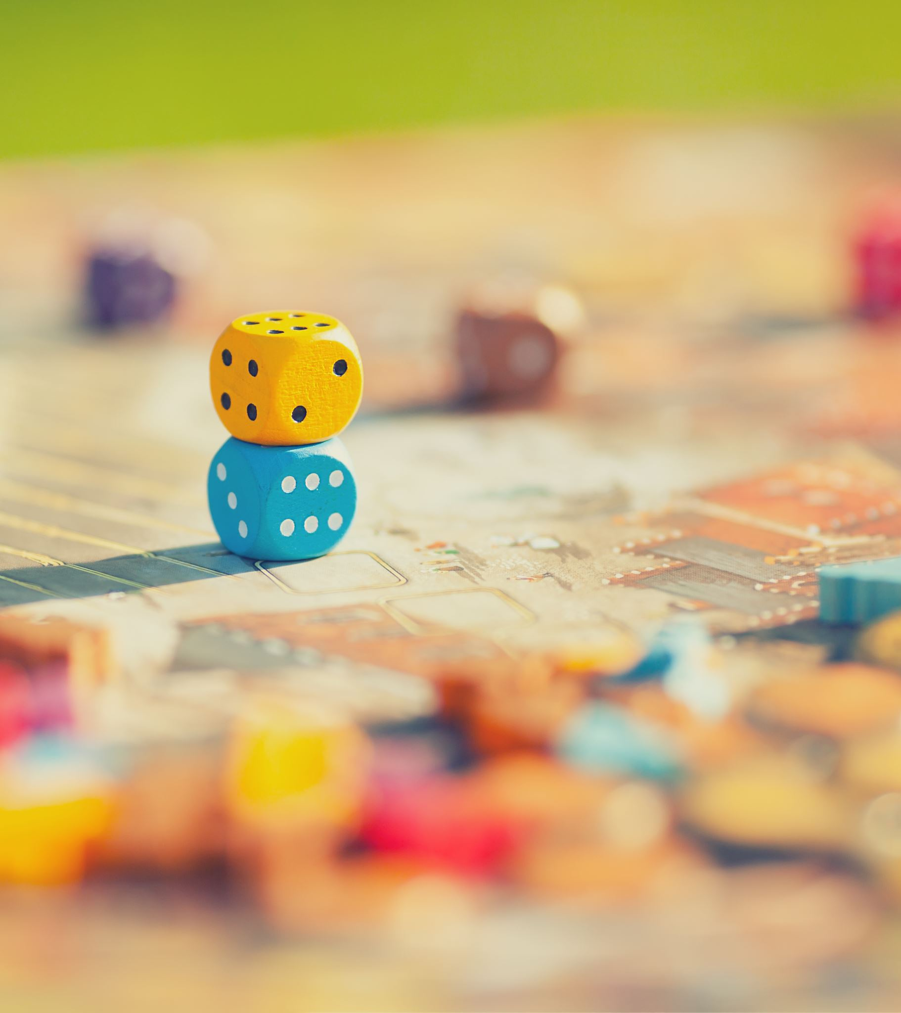
Game Features
Our game includes:
Quiz levels
Feedback messages
Coins and rewards
Hero selection
Score system
Cyber-security challenges
Players earn points and rewards when they choose the safest answer.

Slide 6

UX & Accessibility
To make the game suitable for children, we used:
Bright and friendly colours
Readable fonts
Large buttons
Simple text
Clear instructions
We also designed the game to be easy to navigate and accessible for all players.

Slide 7

Tools Used
We used:
HTML
CSS
JavaScript
Visual Studio Code
GitHub
We selected these tools because they are simple, flexible, and suitable for creating an interactive web-based game.”

Slide 8
Prototype Demo
Our prototype currently includes:
Welcome page
How to Play section
First quiz challenge
Feedback system
Rewards and score display
Players can answer questions and immediately see feedback.”

Slide 9
Challenges & Improvements
In the future, we plan to:
Add more levels
Add animations and sounds
Improve the design
Add more cyber-security topics
Add rewards and scored system

Slide 10
Conclusion
CybShield is designed to help children learn cyber safety in a fun and interactive way.
Our goal is to help young users become smarter and safer online.

